Slide 1

Goal-Based Agent for Healthcare Diagnosis
Technical Presentation-CSA1717 Artificial Intelligence
STUDENTS DETAILS:
Agilan Viyash.S-192511346
Bharath.R-192511129
Barani Kumar.JP-192511005
GUIDED BY:
Dr.M.Anoop

Slide 2
Abstract
A Goal-Based Agent for Healthcare Diagnosis is an artificial intelligence system designed to support healthcare professionals in making accurate and data-driven decisions. The agent collects and analyzes patient information such as symptoms, medical history, vital signs, and laboratory results to achieve specific diagnostic goals. Using decision-making logic, it evaluates possible diagnoses and compares suitable treatment pathways based on the available data. The system follows a structured data pipeline from patient data collection to diagnosis and treatment recommendation. By providing fast and systematic analysis, the goal-based agent can assist doctors in improving diagnostic efficiency, personalized care, and treatment planning.

Slide 3
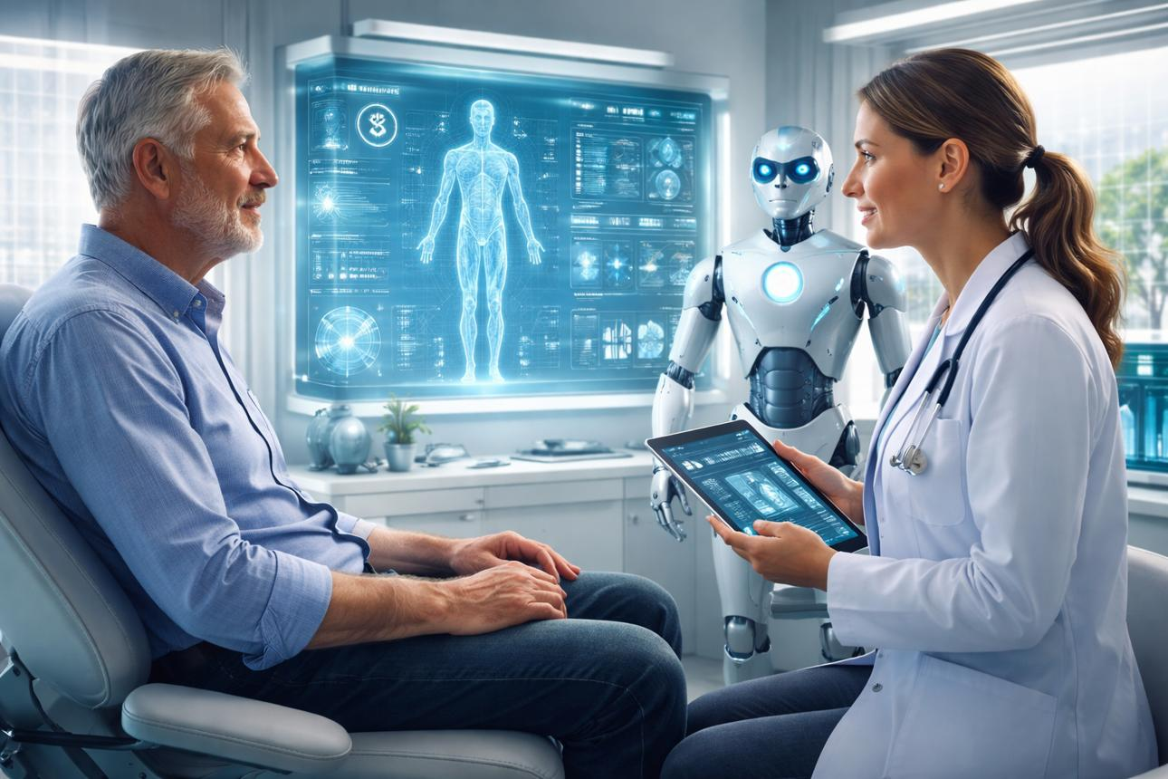
Introduction
Artificial Intelligence is increasingly used in healthcare.
A Goal-Based Agent makes decisions by working toward a specific goal.
In healthcare, the main goal can be accurate diagnosis and selection of a suitable treatment pathway.
The agent analyzes patient information and evaluates possible actions.

Slide 4
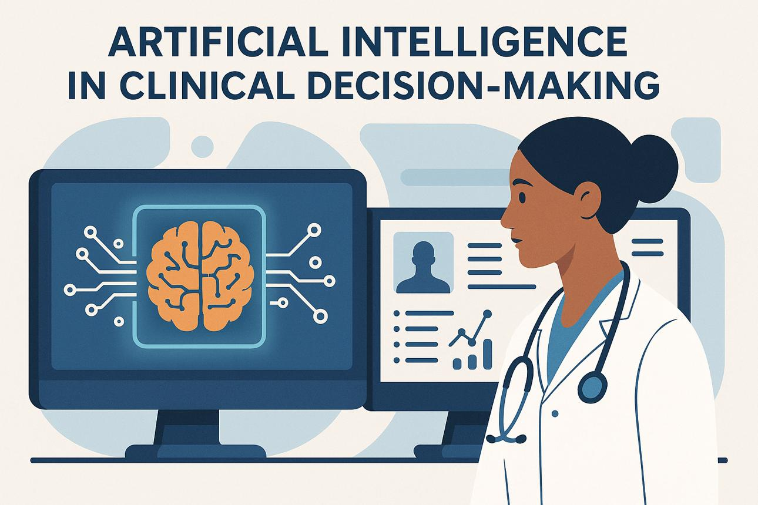
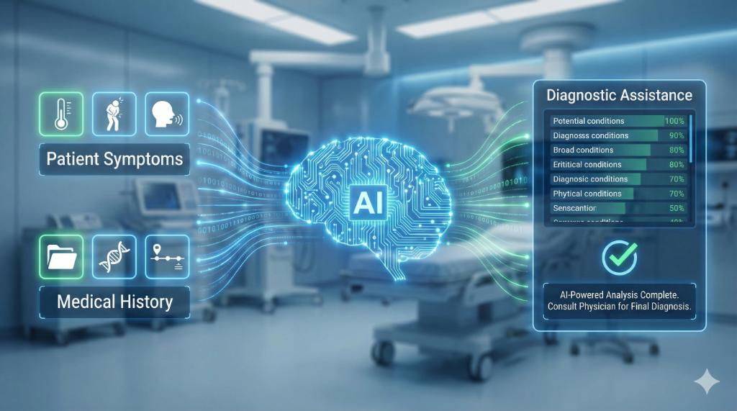
Objectives
Analyze patient data efficiently.
Set appropriate diagnostic goals.
Identify possible diseases or conditions.
Compare different treatment options.
Select the most suitable treatment pathway.
Support doctors in decision-making.
Reduce errors and improve healthcare efficiency.

Slide 5
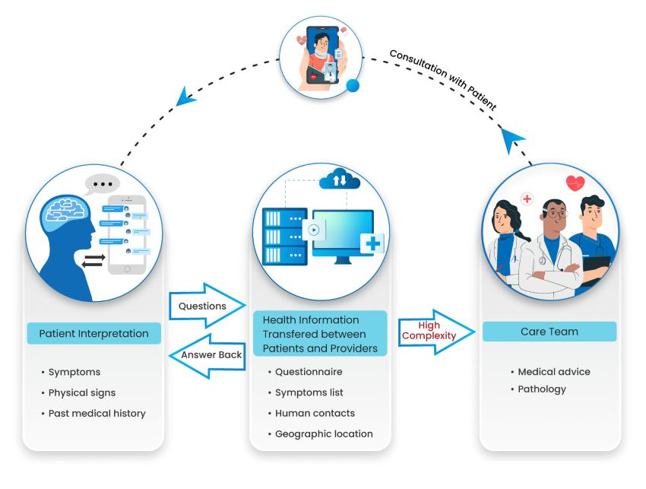
Patient Data & Information Processing
The agent collects different types of patient information, including:
Symptoms and complaints
Medical history
Vital signs
Laboratory test results
Medical reports
The collected data is processed and analyzed to identify important patterns and information required for diagnosis.

Slide 6
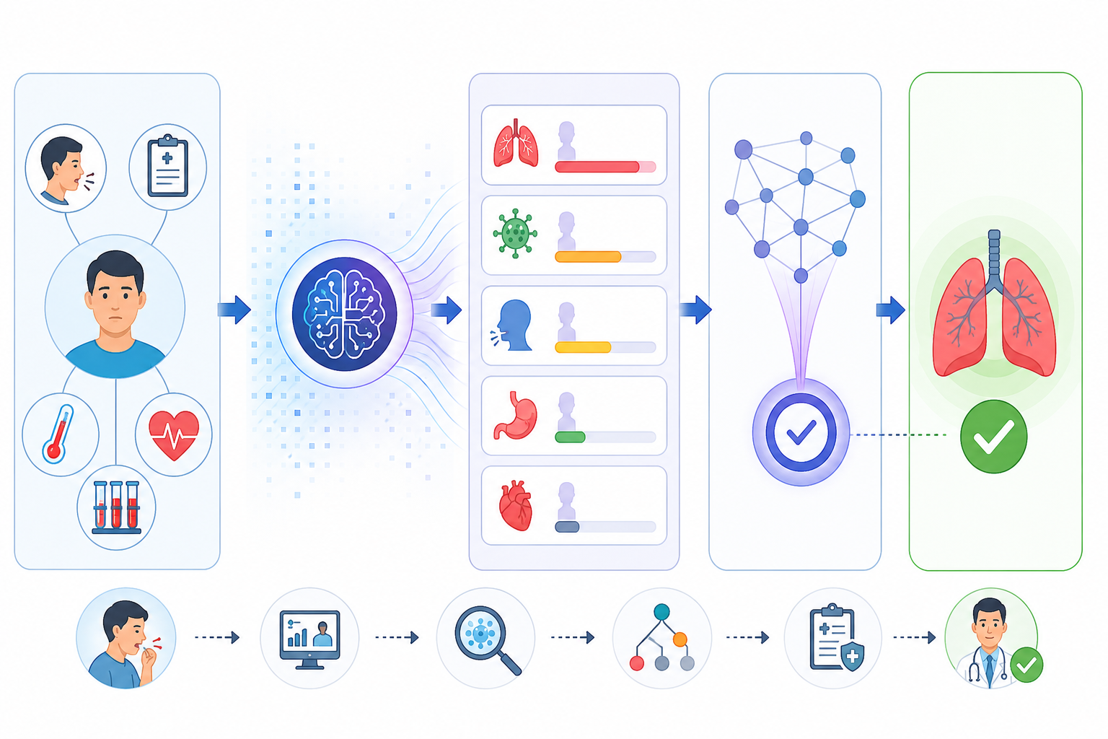
Goal-Based Diagnosis
Setting Diagnostic Goals
The agent first establishes a specific diagnostic goal.
It evaluates the patient's symptoms and medical information.
Multiple possible diagnoses can be considered.
Each possibility is evaluated using available evidence.
The agent selects the most appropriate diagnostic outcome based on the defined goal.
Example:
Fever + Cough + Test Results → Evaluate Possible Conditions → Identify Most Likely Condition

Slide 7
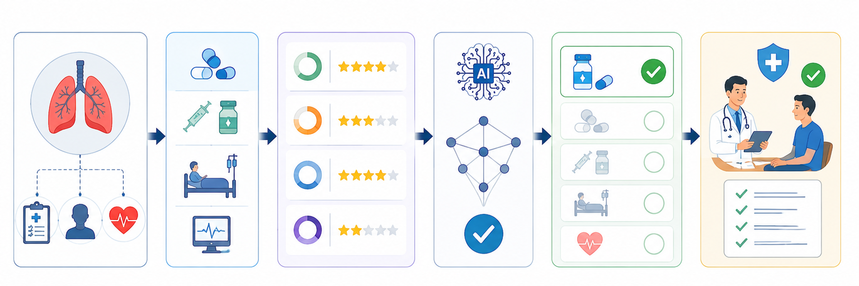
Decision-Making & Treatment Selection
Selecting the Optimal Treatment Pathway
The agent evaluates possible treatment options.
It considers patient-specific information and diagnostic results.
Different pathways are compared using decision-making logic.
The most suitable pathway is selected as a recommendation.
The recommendation can then be reviewed by a healthcare professional.
Flow: Diagnosis → Evaluate Options → Compare Pathways → Recommended Treatment

Slide 8
Data Pipeline & Applications
Data Collection
Data Processing
Analysis
Decision Making
Recommendation
Applications:
Clinical decision support
Disease diagnosis assistance
Patient risk assessment
Treatment planning
Personalized healthcare
Early detection support

Slide 9
Advantages & Conclusion
Advantages
Faster analysis of patient information
Supports data-driven decisions
Helps compare treatment options
Can support personalized care
Reduces repetitive analysis
Conclusion: A goal-based agent combines patient data, diagnostic goals, and decision-making logic to support healthcare diagnosis and treatment planning. It can improve the efficiency of clinical decision support while keeping the final medical decision under the supervision of qualified healthcare professionals.

Slide 10
